Slide 1


Slide 2

understand how humans interact with the
World
understand how to apply HCI knowledge
to design a “better” interfaces
know how to plan and execute HCI design
process.

Slide 3

• Human-computer interaction is the study of how human interact with computers.
– increased user satisfaction
– better productivity
– safer
– ……
• User-centered design
– Designing interactive products to support people in their
everyday and working lives
• Interaction design is the art of facilitating interactions between humans mediated by products.

Slide 4


50s - Interface at the hardware level for
engineers – switch panels

Slide 5
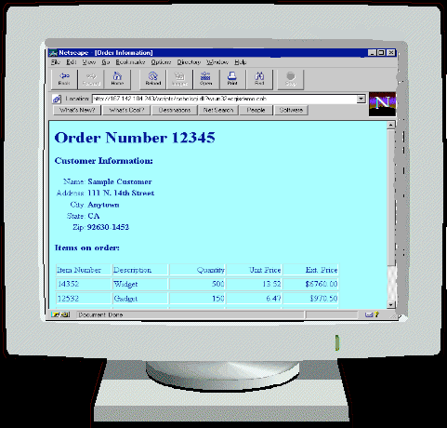
60-70s - interface at the programming
level - COBOL

Slide 6
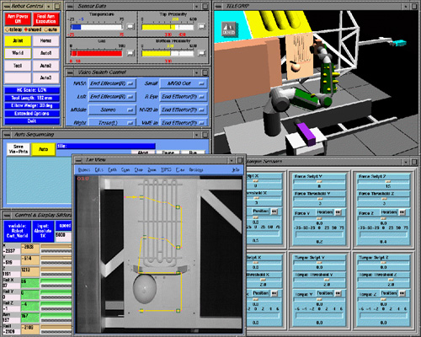
80s - Interface at the interaction dialogue
level – Graphical User Interfaces (GUIs)

Slide 7
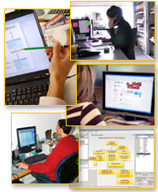
90s - Interface at the work setting - networked systems, groupware

Slide 8
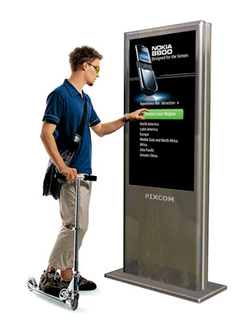
00s - Interface becomes pervasive such as
Bluetooth technology, mobile devices, and
interactive screens

Slide 9

Good design is not easy
Too many bad designs
Interactive system design is all about tradeoffs.

Slide 10

Identify user’s needs and requirements
Conceptualize alternative interface designs
Prototype these design
Evaluate and assess

Slide 11

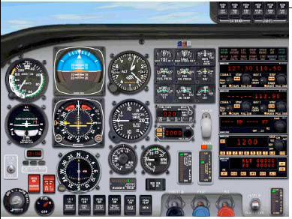
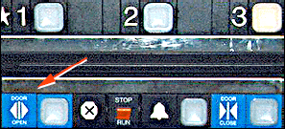

Slide 12
